Slide 1


Slide 2
Do not depend on others for safety Help yourself.

Slide 3
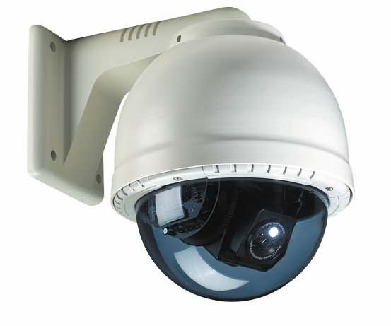
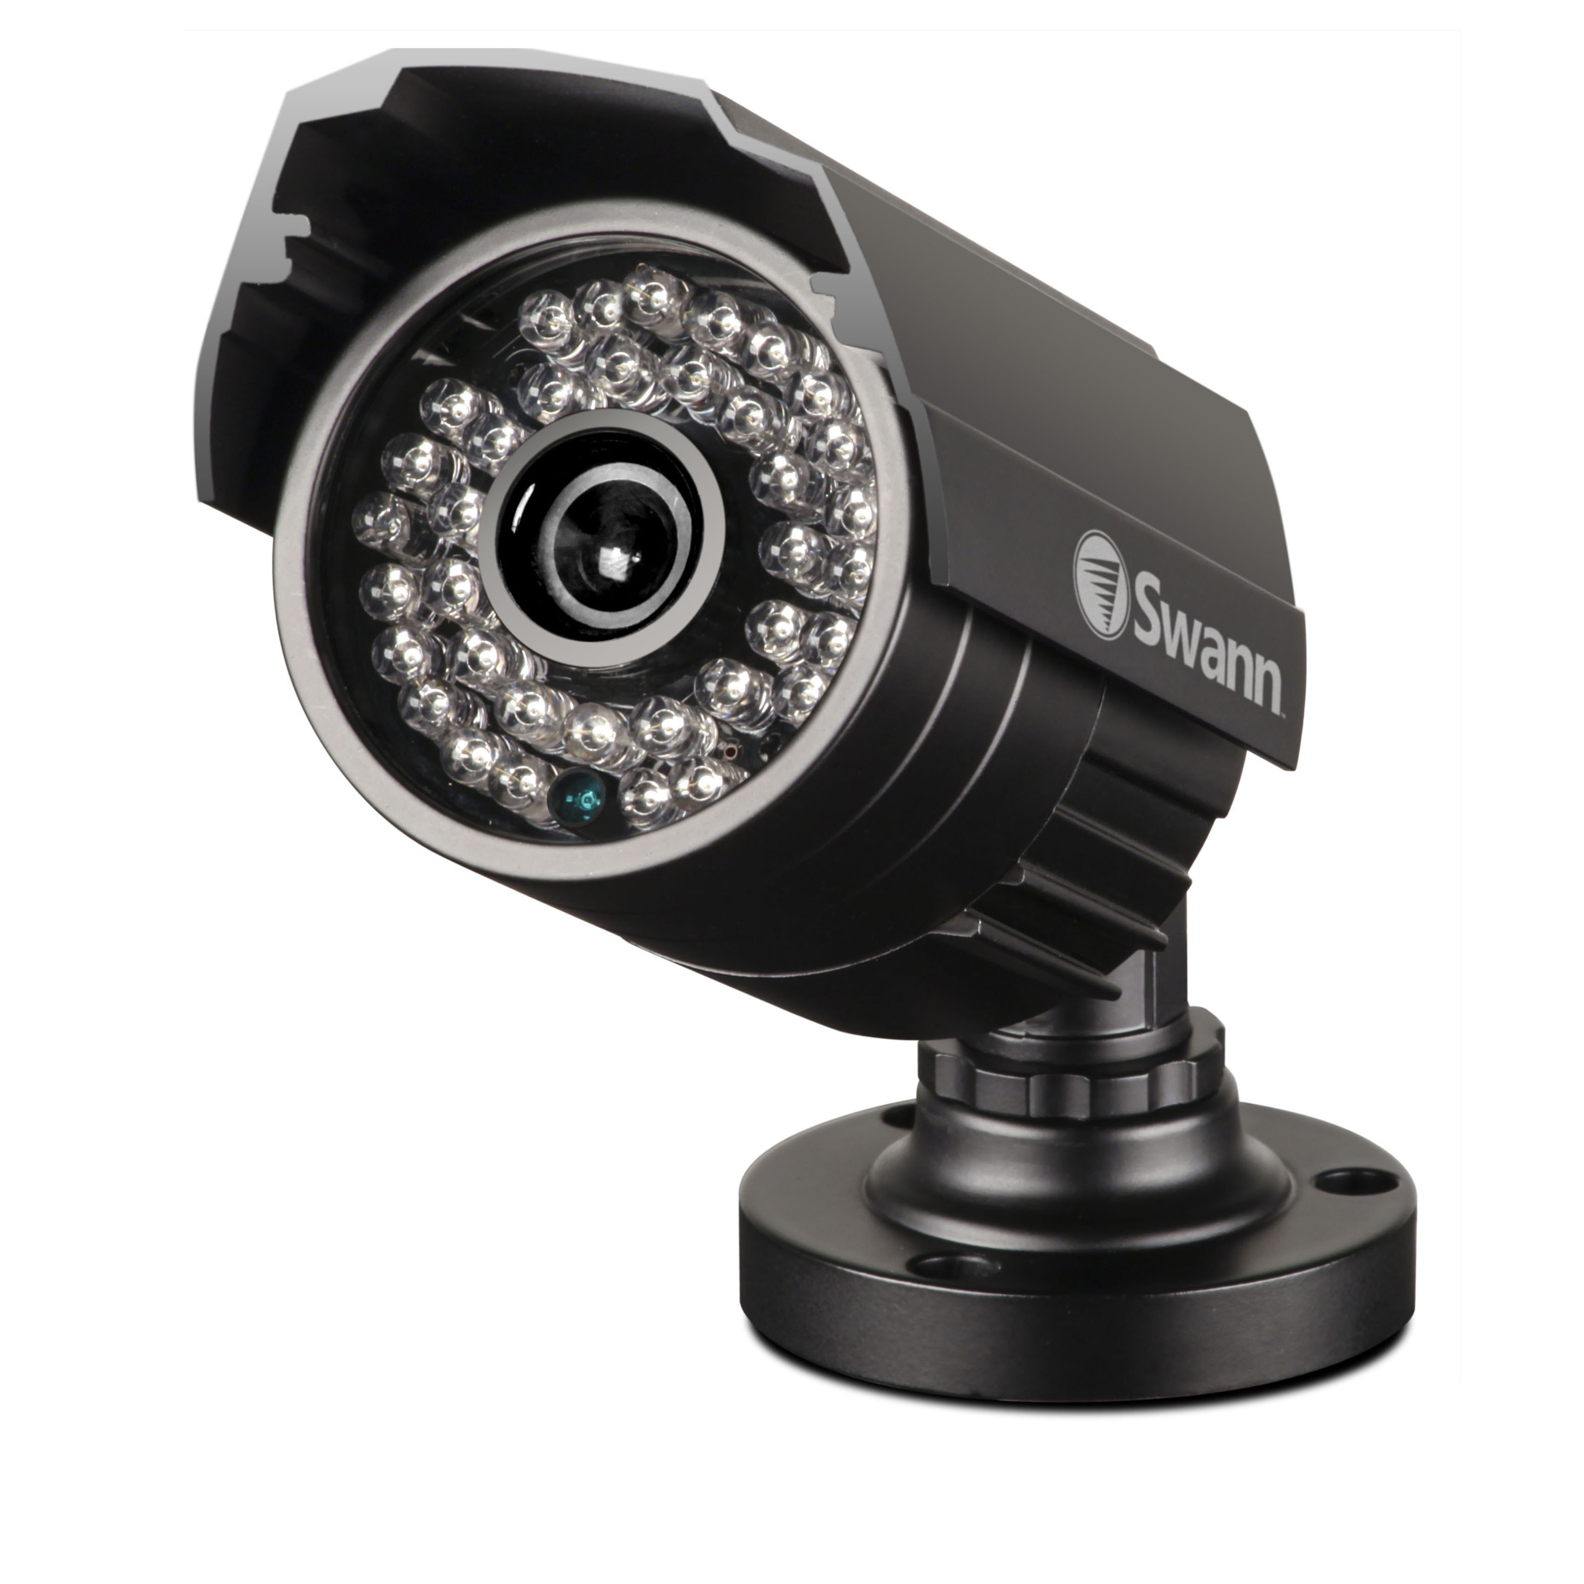
Present problems in the World
Most of the security cameras are just recording
A modern security camera costs more than $200
High power consumption
High maintenance cost
Heavy and large in size

Slide 4
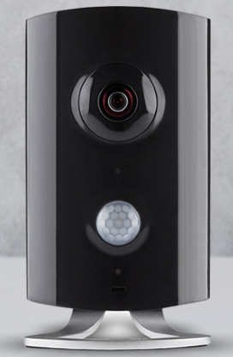
Introducing
** Final Product

Slide 5
Main Functions
Motion triggered image capture.
Mobile notifications with photos.
Detects when you are home and arms or disarms automatically.
Can be remotely disabled or queried for status using Telegram.

Slide 6




Technologies Used
Raspbian OS
Telegram bot Platform
Python 2.7
Scapy tool

Slide 7
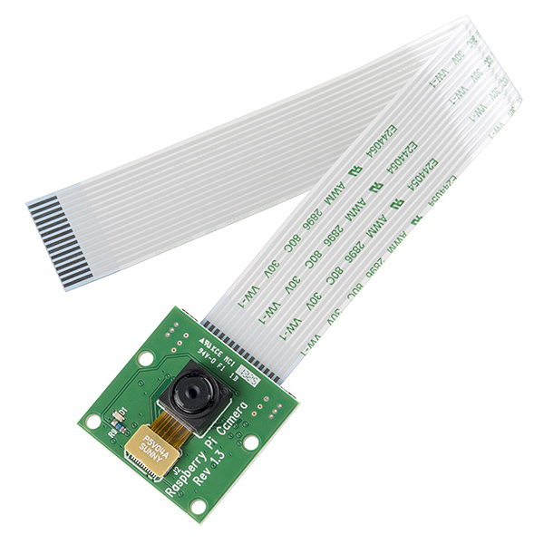
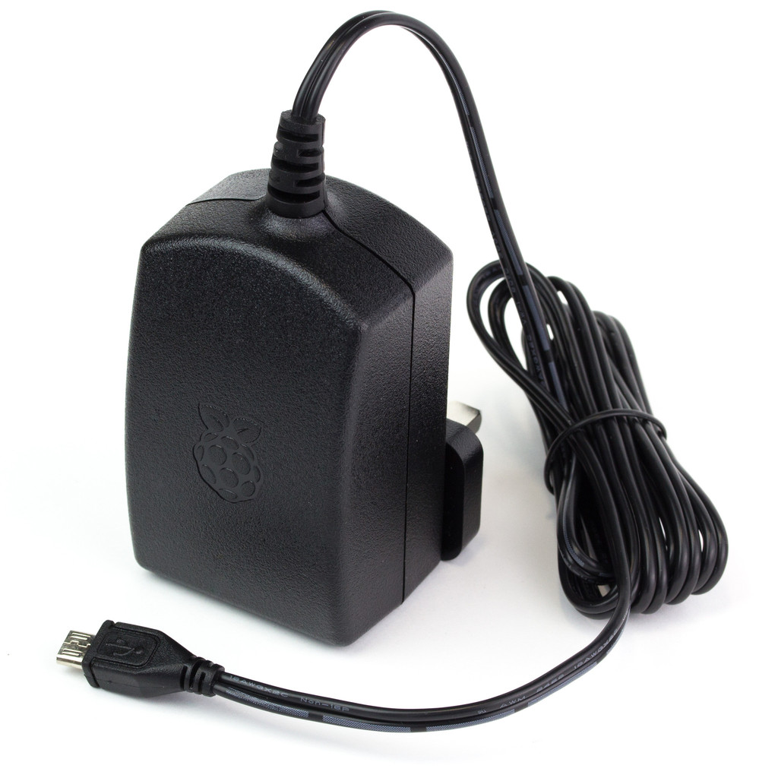
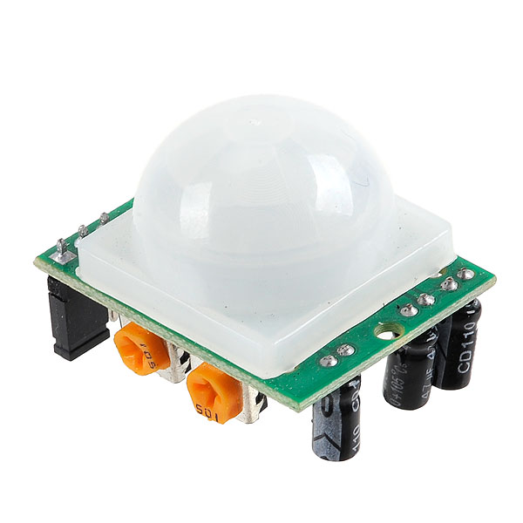
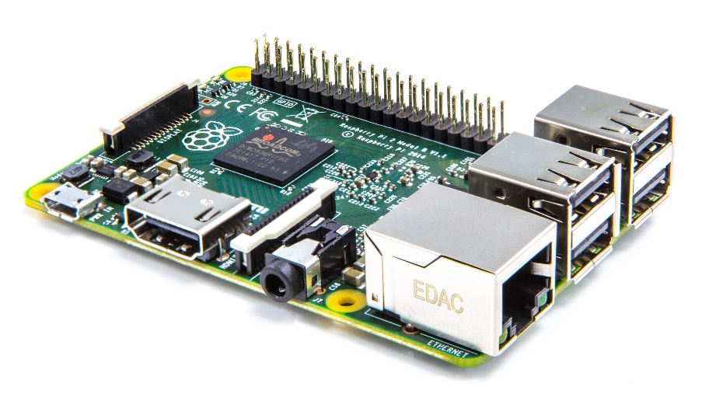
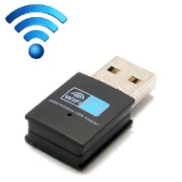
Structure of the SECURA Pi CAM
Camera module
Power Supply
PIR Motion Sensor
Raspberry Pi
Wi-Fi adapter

Slide 8
How does it work
Searching for data packets from configured MAC address on configured wireless network
If data packets detected -Automatic Disarming
If no data packet detected for 2 minutes -Automatic Arming
Automatic Arming
after 2 minutes
If Armed and Motion Detected, captures 5 pictures
Sends captured Pictures to mobile through Telegram app
Configure and run the program
Commands
/status
/enable
/disable
Checking for commands from Telegram app on mobile
Sends Reply according to command to Telegram app on mobile

Slide 9

Marketing Research Study

Slide 10
Marketability
As the product is unique, the market share is high
People’s busy lives makes a good market. (Smart product)
People’s appetite on new technological gadget.

Slide 11

Cost per SECURA Pi Cam product
**Assuming monthly 500 products
Hardware cost | $100 * 500 | $50 000
Software cost | $10 * 500 | $5 000
Salaries | $40 * 4 | $160
Testing | $2 * 5 | $10
Other cost | $10 | $10
Contingency | $15 | $15
Total |  | $55 195
Profit 10% | $55 195 + $5 520 | $60 720
Cost per item | $60 720 / 500 | $121.44
$121.44

Slide 12


Competitor Analysis
Features | SECURA Pi CAM | Traditional Systems | Wi-Fi Cameras
Average Cost | $121.50 | $1,500+ | $200-$500
Auto-Arm/Disarm
Motion Detection
Intelligent Notifications
Multiple User accessible

Slide 13
Future Development
Include a rechargeable battery to power up
Introduce a dedicated mobile application
Upload images and video footages real time to the cloud service
Implement Pan & Tilt feature and control through the app

Slide 14
Thank You!

